Slide 1

Leveraging-Data-Visualization-for-Sales-Optimization
"Unlock the Power of Data, Drive Sales Success with Sales Insights Dashboard!"
Submitted By:
Name : Ishank verma UID : 21MCA2983 Section : MCA 6A UIC, Chandigarh University

Slide 2

Problem
SNS Hardware, a computer hardware and peripherals company, faced challenges in tracking sales and gaining insights into its business performance.
The rely on verbal communication and Excel files made it difficult to obtain a comprehensive view of sales trends, customer engagement, and areas requiring attention.
The absence of a visual representation of data hindered the ability to make informed decisions based on accurate and real-time information.
The problem statement aimed to develop a Sales Insight Dashboard using MySQL and Power BI to consolidate sales data, provide real-time insights, and improve decision-making processes for increased sales revenue and customer satisfaction.

Slide 3
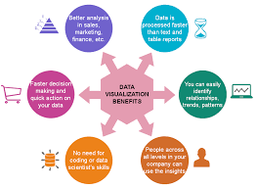
Benefits of Data Visualization in Decision-Making
Visualizations help identify trends and patterns quickly.
Decisions can be made up to three times faster with improved accuracy.

Slide 4

Data Analytics and Business Growth
Analytics-driven decision-making leads to above-average profitability and growth.
The Sales Insight Dashboard facilitates real-time data and actionable insights.

Slide 5
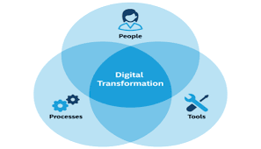
Digital Transformation and Real-Time Data Analysis
Digitization emphasizes the importance of real-time data analysis for growth.
The Sales Insight Dashboard provides timely information for informed decision-making.

Slide 6

Relevance of the Sales Insight Dashboard Project
The project applies to various industries, aiding data-driven decision-making.
Improves customer engagement and revenue generation.

Slide 7
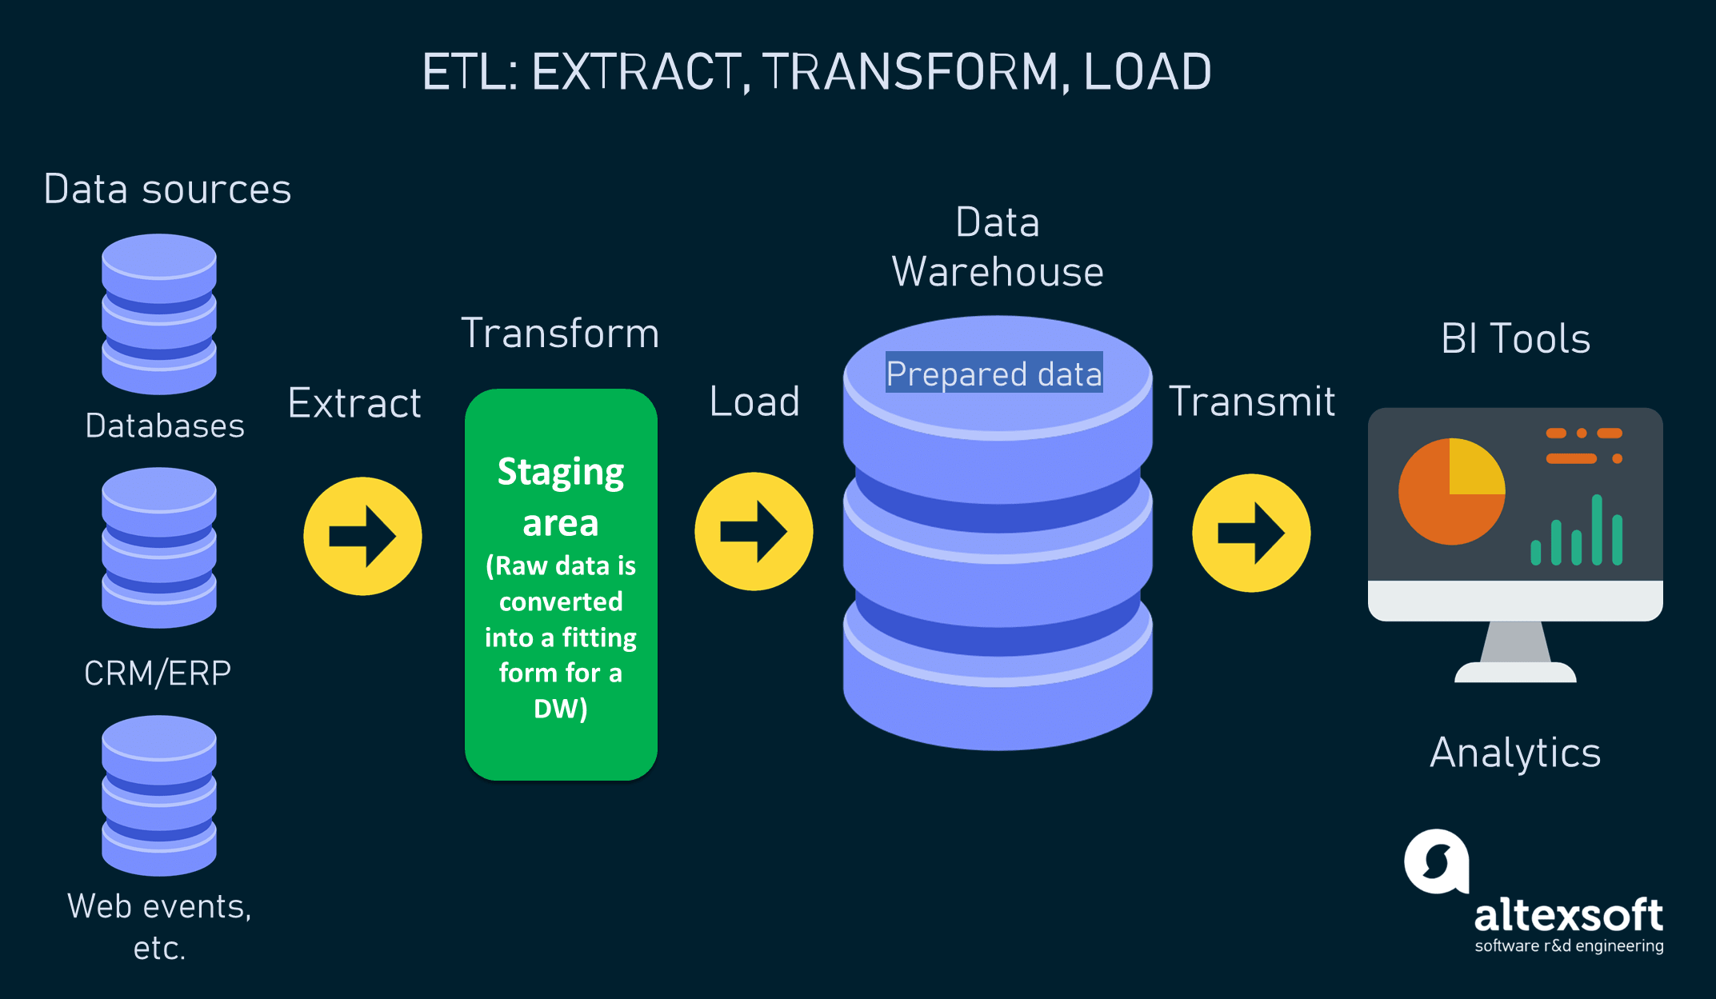
Project Implementation and Methodology
Collecting and consolidating sales data ensures comprehensive insights.
Development of a Power BI dashboard enables visual representation.

Slide 8
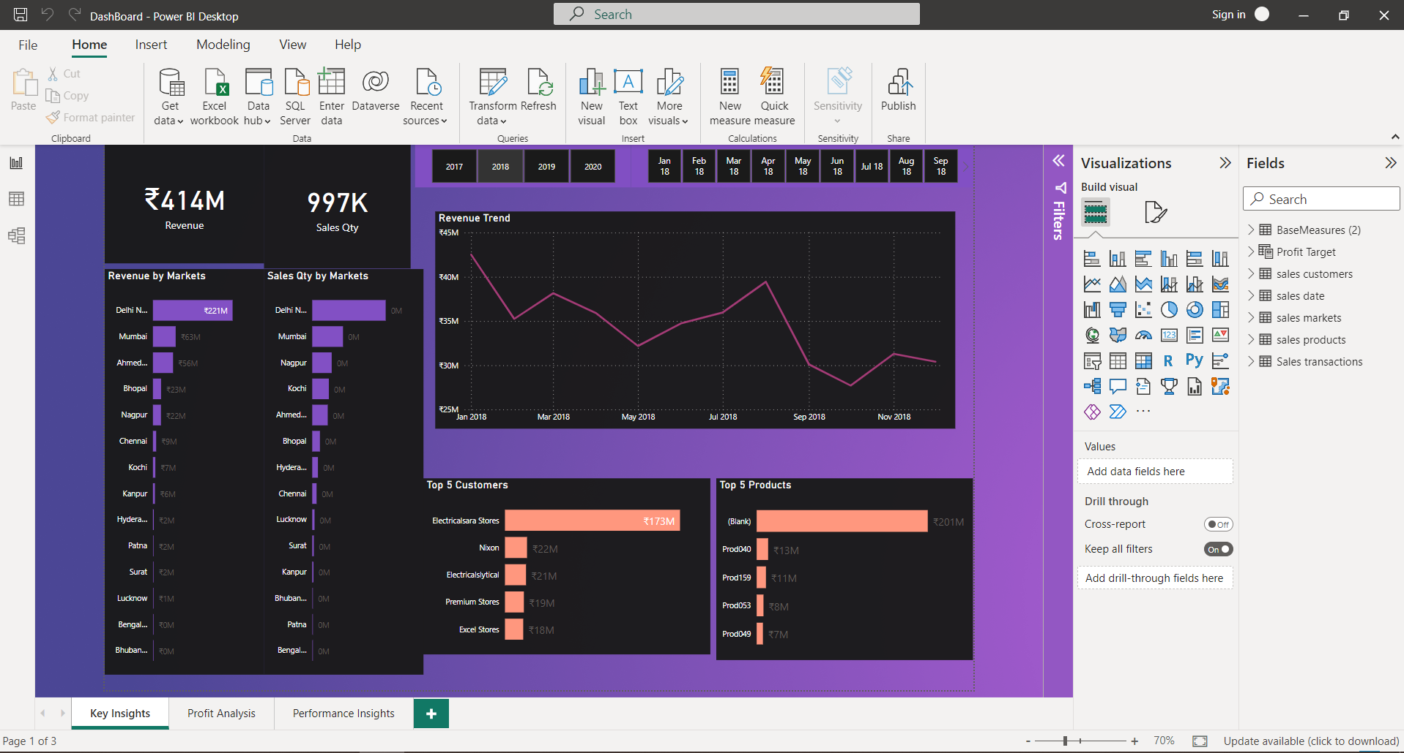
Key Insights dashboard

Slide 9
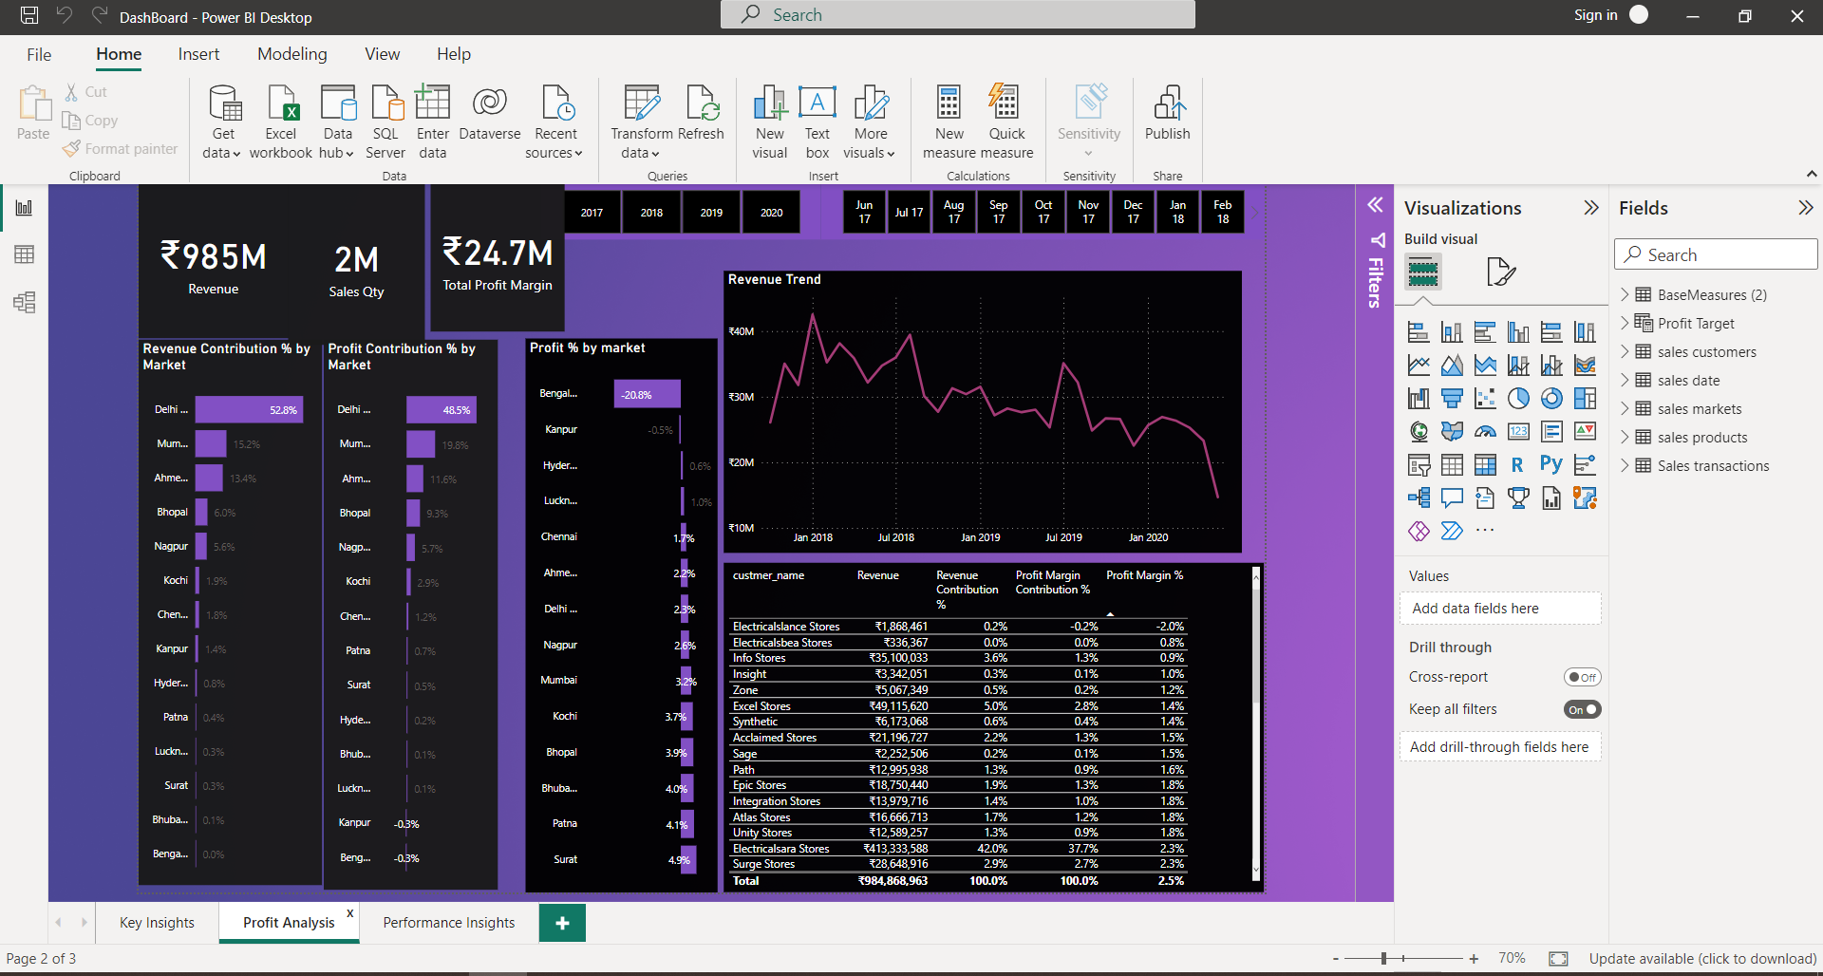
Profit Analysis dashboard

Slide 10
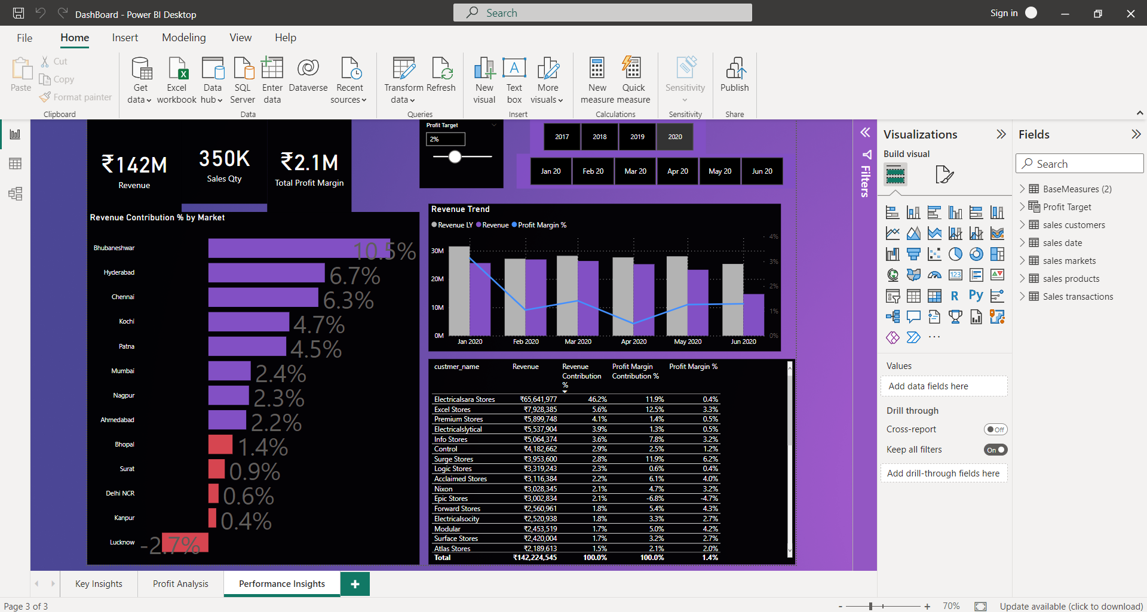
Performance Insights dashboard

Slide 11

Conclusion
The Sales Insight Dashboard project provides a transformative solution for businesses, enabling data-driven decision-making, improved sales performance, and growth. By harnessing real-time data analysis and empowering key decision-makers, it aligns with digital transformation trends, leading to enhanced sales strategies, customer engagement, and increased revenue.

